Slide 1
INFINITE SERIES

Slide 2
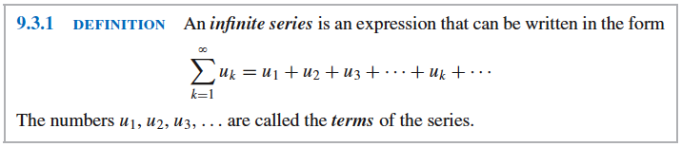
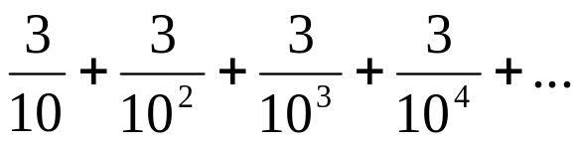
Consider the decimal 0.33333....
INFINITE SERIES
This can be viewed as the infinite series
0.3 + 0.03 + 0.003 + 0.0003 + …
or, equivalently,

Slide 3
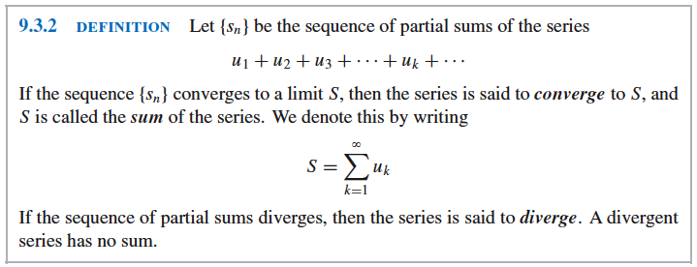
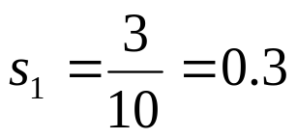
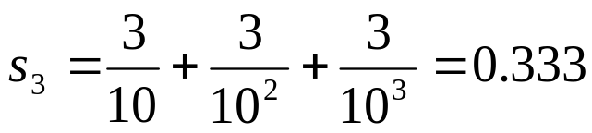
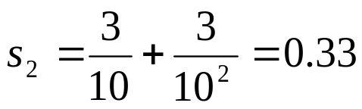
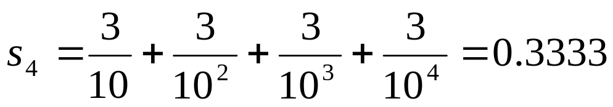
To obtain such above definition, consider the following sequence of (finite) sums of 1/3:
and so on.

Slide 4
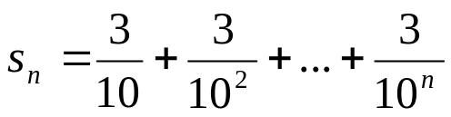
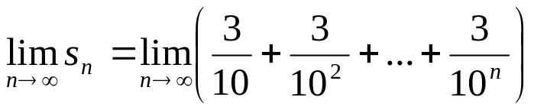
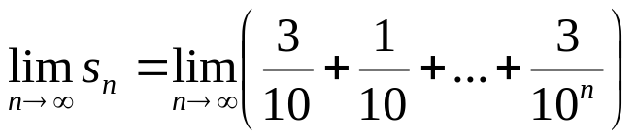
The sequence of numbers s₁ , s₂ , s₃ , s₄, …can be viewed as a succession of approximation
to the “sum” of the infinite series, which is 1/3.
Calculating the limit of the general term of the sequence of approximations, namely,

Slide 5
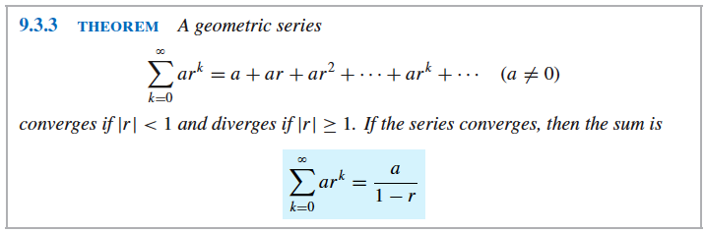
GEOMETRIC SERIES
In many important series, each term is obtained by multiplying the preceding term by some fixed constant. Thus, if the initial term of the series is a and each term is obtained bymultiplying the preceding term by r, then such series are called geometric series.

Slide 6

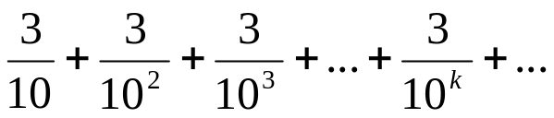
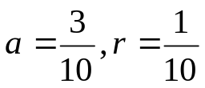
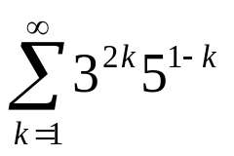
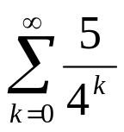
GEOMETRIC SERIES
Examples:
1 + 2 + 4 + 8 + … + + …
a=1 , r = 2
Sample Problems:
1. In each part, determine whether the series converges, and
if so, find its sum.
b.
Find the rational number (or fraction) represented by the
repeating decimal.
0.784784784… b. 5.373737…

Slide 7
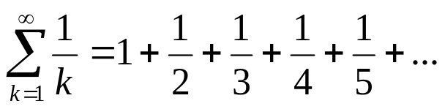
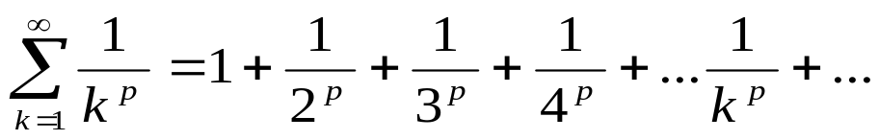
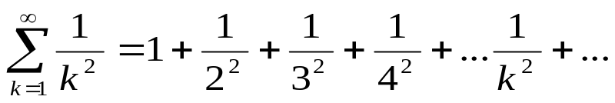
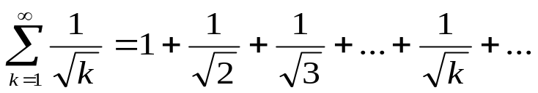
HARMONIC SERIES
One of the most important of all diverging series is the harmonic series, which is
of the form:
HYPERHARMONIC SERIES OR P-SERIES
A p-series or hyperharmonic series is an infinite series of the form:
Examples of p-series are:

Slide 8
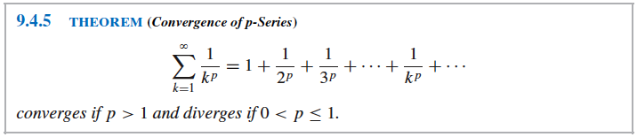
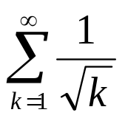
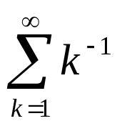
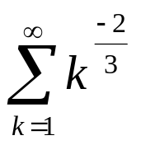
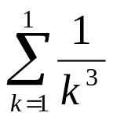
HYPERHARMONIC SERIES OR P-SERIES
Examples:
For each given p-series, identify p and determine whether the series converges:
#3/p. 629
a. b. c. d.

Slide 9
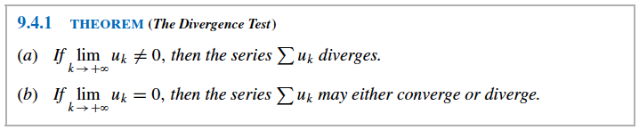
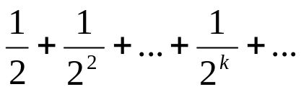
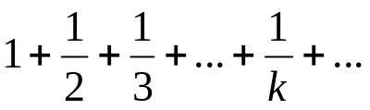
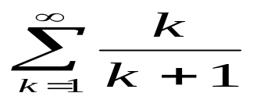
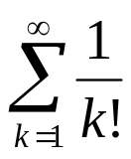
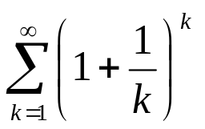
CONVERGENCE TESTS
1. Divergence Test
Examples: Apply the divergence test and state what it tells you about the series:
Examples p. 624
b. c.
#5/p.629
b. d.

Slide 10
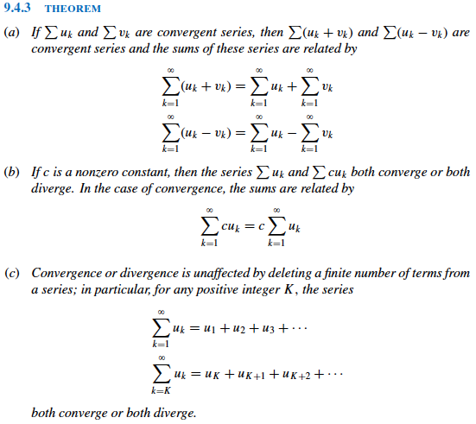
ALGEBRAIC PROPERTIES OF INFINITE SERIES

Slide 11
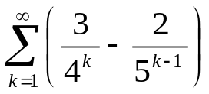
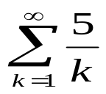
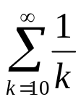
ALGEBRAIC PROPERTIES OF INFINITE SERIES
Examples: pp.625-626
Find the sum of the series
Determine whether the following series converge or diverge.
a. b.

Slide 12
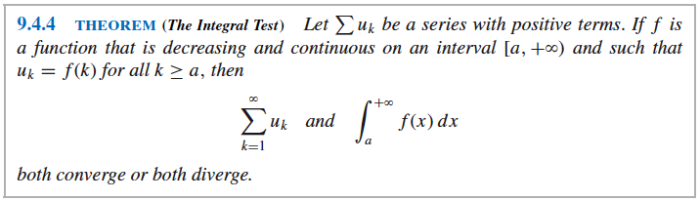
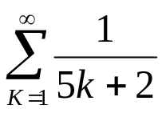
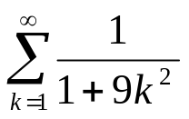
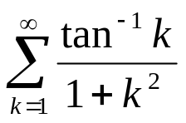
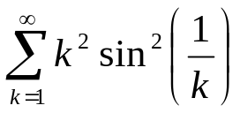
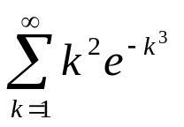
2. Integral Test
Examples: Confirm that the integral test is applicable and use it to determine whether the
Series converges.
p. 629 #’s 7a and 7b
#7a. # 7b.
2. #19 p.629 3. #21 p.629 4. # 22 p.629

Slide 13
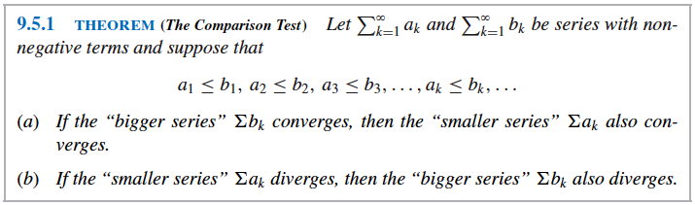

3. Comparison Test
There are two steps required for using the comparison test to determine whether a series
with positive terms converges:
Guess at whether the series converges or diverges.
Find a series that proves the guess to be correct. That is, if we guess that
diverges, we must find a divergent series whose terms are “smaller” than the correspond-
ing term of and if we guess that converges, we must find a convergent
series whose terms are “bigger” than the corresponding terms of .

Slide 14
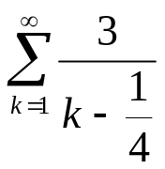
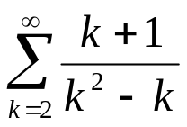
3. Comparison Test
To help with the guessing process, the following guide or informal principle can be used
That are based on the form of the denominator of .
Constant terms in the denominator of can usually be deleted without affecting
the convergence or divergence of the series.
If a polynomial in k appears as a factor in the numerator or denominator of
all but the leading term in the polynomial can usually be discarded without affecting the
convergence or divergence of the series.
Examples: Make a guess about the convergence or divergence of the series, and confirm
your guess using the comparison test
1. 1b/p. 636 2. # 2b/p.636

Slide 15
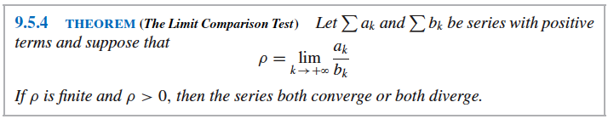
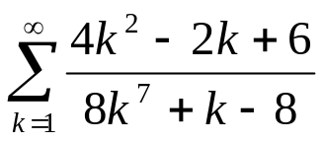
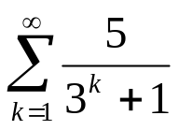
4. Limit Comparison Test
Examples: Use the limit comparison test to determine whether the series converges.
1. #5/p.636 2. #7/p.636

Slide 16
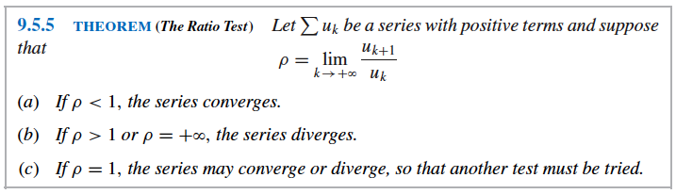
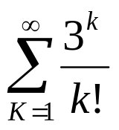
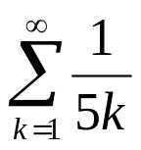
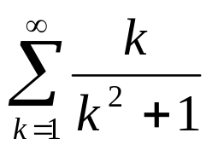
5. Ratio Test
Examples: Use the ratio test to determine whether the series converges. If the test is
Inconclusive, then say so.
1. #11/p.636 2. #13/p.636 3. #16/p.636

Slide 17



6. Root Test
Examples: Use the root test to determine whether the series converges. If the test is
inconclusive, then say so.
1. #18/p.636 2. #20/p.636

Slide 18


ALTERNATING SERIES
Series whose terms alternate between positive and negative are called alternating series.
It is one of these forms:

Slide 19


Examples: Determine whether the alternating series converges; justify your answer.
1. #4/p.646 2. # 6/p.646

Slide 20


ABSOLUTE CONVERGENCE

Slide 22

Theorem 9.6.5 (p. 644)
Ratio Test for Absolute Convergence

Slide 23

Page 645
Summary of Convergence Tests

Slide 24

Page 645
Summary of Convergence Tests

Slide 25


MACLAURIN AND TAYLOR POLYNOMIAL

